Slide 1
House Price Prediction Project
By
Girija Chandra Mohan

Slide 2
INTRODUCTION BUSINESS PROBLEM FRAMING
Houses are one of the necessary needs of each and every person around the globe and therefore housing and real estate market is one of the markets which is one of the major contributors in the world’s economy. It is a very large market and there are various companies working in the domain.
Data science comes as a very important tool to solve problems in the domain to help the companies increase their overall revenue, profits, improving their marketing strategies and focusing on changing trends in house sales and purchases. Predictive modeling, Market mix modeling, recommendation systems are some of the machine learning techniques used for achieving the business goals for housing companies. Our problem is related to one such housing company.
We are required to model the price of houses with the available independent variables. This model will then be used by the management to understand how exactly the prices vary with the variables. They can accordingly manipulate the strategy of the firm and concentrate on areas that will yield high returns. Further, the model will be a good way for the management to understand the pricing dynamics of a new market

Slide 3
CONCEPTUAL BACKGROUND OF THE DOMAIN PROBLEM
A US-based housing company named Surprise Housing has decided to enter the Australian market. The company uses data analytics to purchase houses at a price below their actual values and flip them at a higher price. For the same purpose, the company has collected a data set from the sale of houses in Australia. The data is provided in the CSV file below.
The company is looking at prospective properties to buy houses to enter the market. You are required to build a model using Machine Learning in order to predict the actual value of the prospective properties and decide whether to invest in them or not. For this company wants to know:
• Which variables are important to predict the price of a variable?
• How do these variables describe the price of the house?

Slide 4
MOTIVATION OF THE PROBLEM UNDERTAKEN
Our main objective of doing this project is to build a model to predict the house prices with the help of other supporting features. We are going to predict by using Machine Learning algorithms.
The sample data is provided to us from our client database. In order to improve the selection of customers, the client wants some predictions that could help them in further investment and improvement in selection of customers.
House Price Index is commonly used to estimate the changes in housing price. Since housing price is strongly correlated to other factors such as location, area, population, it requires other information apart from HPI to predict individual housing price.
There has been a considerably large number of papers adopting traditional machine learning approaches to predict housing prices accurately, but they rarely concern themselves with the performance of individual models and neglect the less popular yet complex models.
As a result, to explore various impacts of features on prediction methods, this paper will apply both traditional and advanced machine learning approaches to investigate the difference among several advanced models. This paper will also comprehensively validate multiple techniques in model implementation on regression and provide an optimistic result for housing price prediction.

Slide 5
MATHEMATICAL/ANALYTICAL MODELLING OF THE PROBLEM
The different Mathematical/Analytical models that are used in this project are as below:
Linear Regression,
Lasso,
Ridge,
KNeighborsRegressor,
Decision Tree Regressor,
Random Forest Regressor,
SVR
First, use the train dataset and do the EDA process, fitting the best model and saving the model.
Then, use the test dataset, load the saved model and predict the values over the test data.

Slide 6
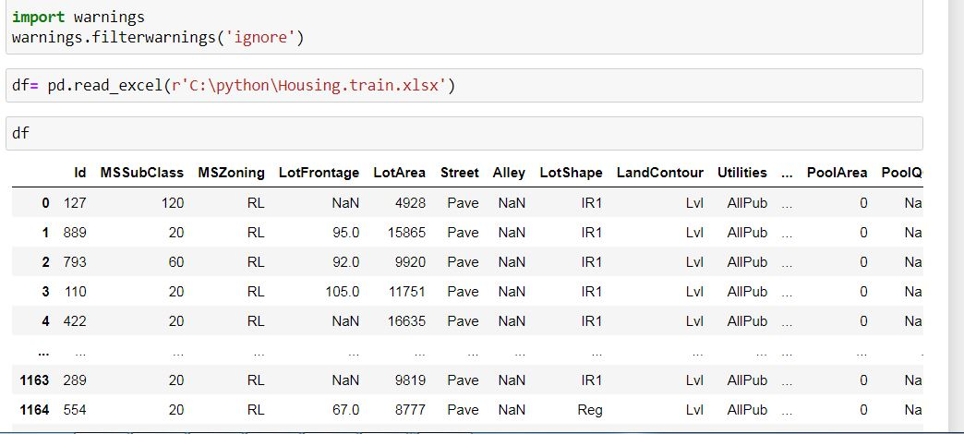
DATA SOURCES AND THEIR FORMATS

Slide 7
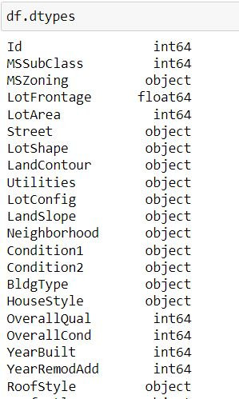
Check For Data Types
This is used to categorize the features into numerical and categorical type which is very useful for the further analysis.

Slide 8
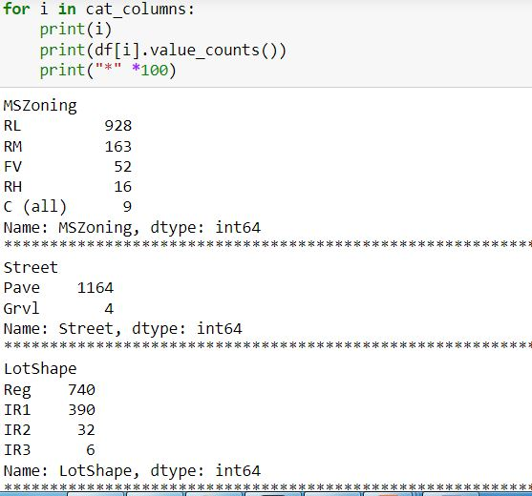
DATA PREPROCESSING
Data pre-processing in Machine Learning refers to the technique of preparing (cleaning and organizing) the raw data to make it suitable for a building and training Machine Learning models. In other words, whenever the data is gathered from different sources it is collected in raw format which is not feasible for the analysis. Data pre-processing is an integral step in Machine Learning as the quality of data and the useful information that can be derived from it directly affects the ability of our model to learn; therefore, it is extremely important that we pre- process our data before feeding it into our model.
Checking the value counts of categorical data

Slide 9
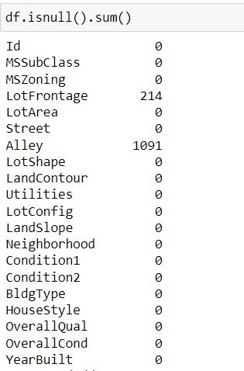
Check For Null Values
Null values in a dataset are to be filled with appropriate statistical values to get better results.

Slide 10
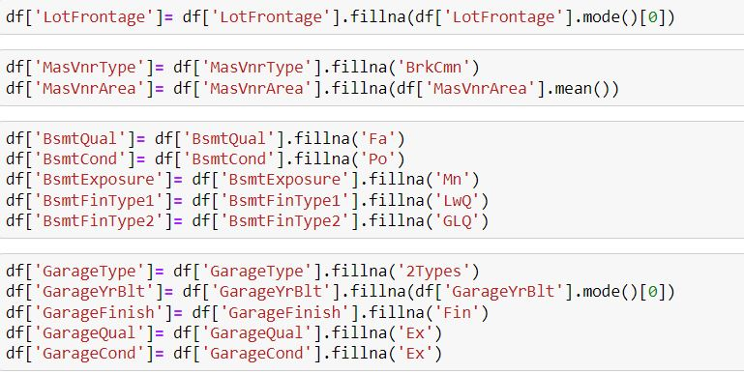
HANDLING MISSING DATA

Slide 11
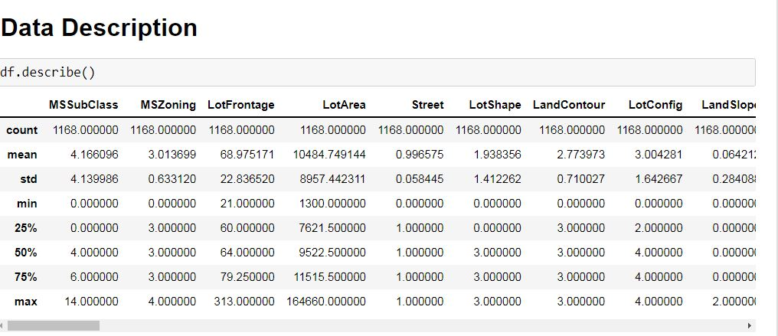
STATISTICAL SUMMARY
In descriptive statistics, summary statistics are used to summarize a set of observations, in order to communicate the largest amount of information as simply as possible. Summary statistics summarize and provide information about your sample data. It tells something about the values in data set. This includes where the average lies and whether the data is skewed.
The describe() function computes a summary of statistics pertaining to the Data Frame columns. This function gives the mean, count, max, standard deviation and IQR values of the dataset in a simple understandable way.

Slide 12
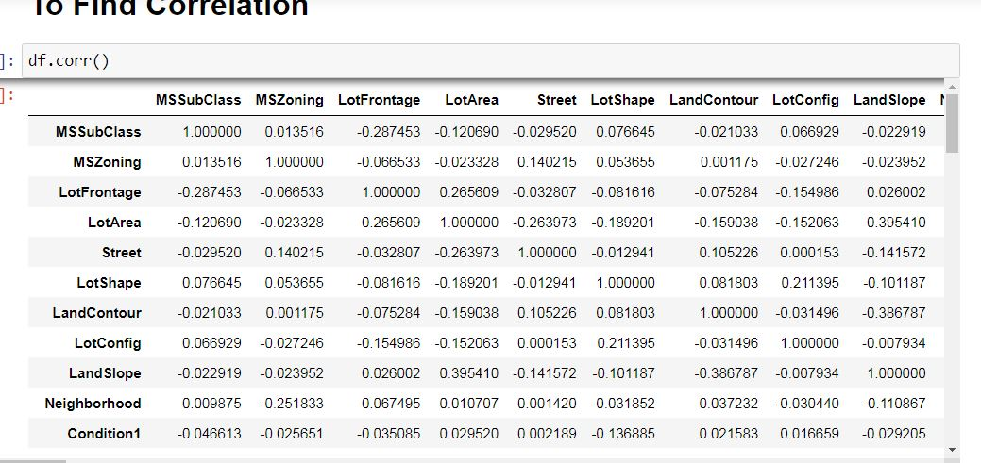
CORRELATION FACTOR
The statistical relationship between two variables is referred to as their correlation. The correlation factor represents the relation between columns in a given dataset.
A correlation can be positive, meaning both variables are moving in the same direction or it can be negative, meaning that when one variable's value increasing, the other variable’s value is decreasing.

Slide 13
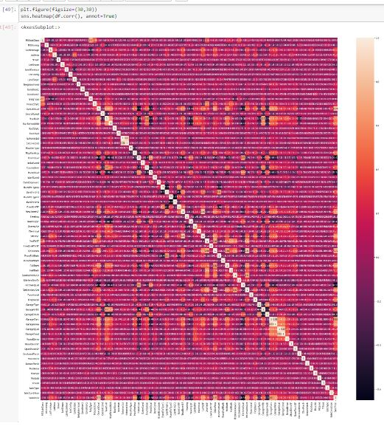
CORRELATION MATRIX AND ITS VISUALIZATION
A correlation matrix is a tabular data representing the ‘correlations’ between pairs of variables in a given dataset. It is also a very important pre-processing step in Machine Learning pipelines. The Correlation matrix is a data analysis representation that is used to summarize data to understand the relationship between various different variables of the given dataset.

Slide 14
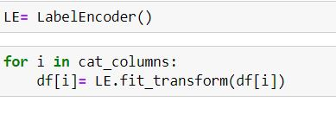
DROPPING UNNECESSARY COLUMNS AND ENCODING NON-NUMERIC DATA USING LABEL ENCODER

Slide 15
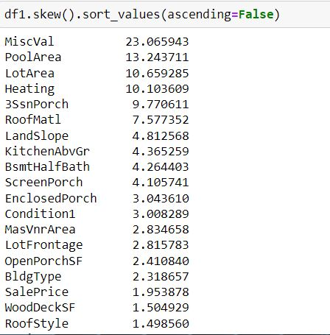
CHECKING SKEWNESS
Skewness refers to distortion or asymmetry in a symmetrical bell curve, or normal distribution in a set of data. Besides positive and negative skew, distributions can also be said to have zero or undefined skew. The skewness value can be positive, zero, negative, or undefined.

Slide 16
CHECKING OUTLIERS
An outlier is a data point in a data set which is distant or far from all other observations available. It is a data point which lies outside the overall distribution which is available in the dataset. In statistics, an outlier is an observation point that is distant from other observations.
A box plot is a method or a process for graphically representing groups of numerical data through their quartiles. Outliers may also be plotted as an individual point. If there is an outlier it will plotted as point in box plot but other numerical data will be grouped together and displayed as boxes in the diagram. In most cases a threshold of 3 or -3 is used i.e., if the Z-score value is higher than or less than 3 or -3 respectively, that particular data point will be identified as outlier.

Slide 17
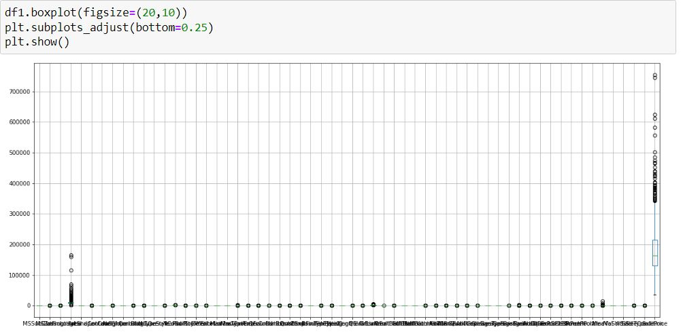

Slide 18

TREATING SKEWNESS
Skewness can be treated in different ways.
Log Transform
Squareroot Transform
Power Transform
Box-cox Transform
Here we use power Transform to treat skewness.

Slide 19
HARDWARE AND SOFTWARE REQUIREMENTS AND TOOLS USED
For doing this project, the hardware used is a laptop with high end specification and a stable internet connection. While coming to software part, I had used anaconda navigator and in that I have used Jupyter notebook to do my python programming and analysis.
For using a csv file, Microsoft excel is needed. In Jupyter notebook, I had used lots of python libraries to carry out this project and I have mentioned below with proper justification:
1. Pandas- a library which is used to read the data, visualisation and analysis of data.
2. NumPy- used for working with array and various mathematical techniques.
3. Seaborn- visualization tool for plotting different types of plot.
4. Matplotlib- It provides an object-oriented API for embedding plots into applications.
5. zscore- technique to remove outliers.
6. skew ()- to treat skewed data using various transformation like sqrt, log, cube, boxcox, etc.
7. standard scaler- I used this to scale my data before sending it to model.
8. train_test_split- to split the test and train data.
9. Then I used different classification algorithms to find out the best model for predictions.
10. joblib- library used to save the model in either pickle or obj file.

Slide 20
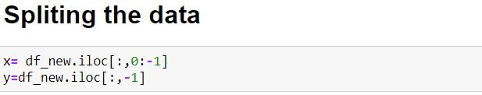
TESTING OF IDENTIFIED APPROACHES
After completing the required pre-processing techniques for the model building data is separated as input and output columns before passing it to the train_test_split.

Slide 21
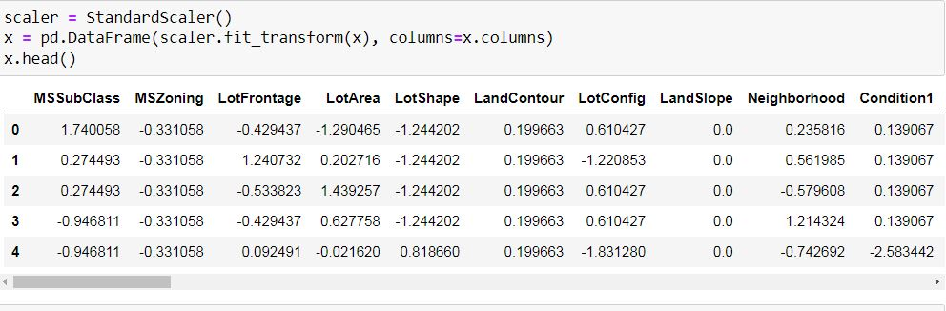
SCALING THE DATA USING STANDARD SCALER

Slide 22
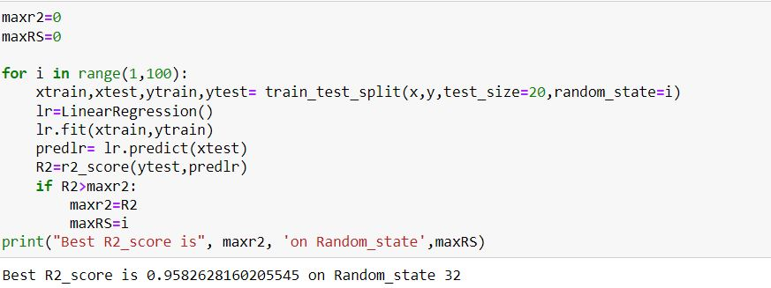
EVALUATE SELECTED MODELS
We will find the best Random State and C fold to run and evaluate the models.

Slide 23
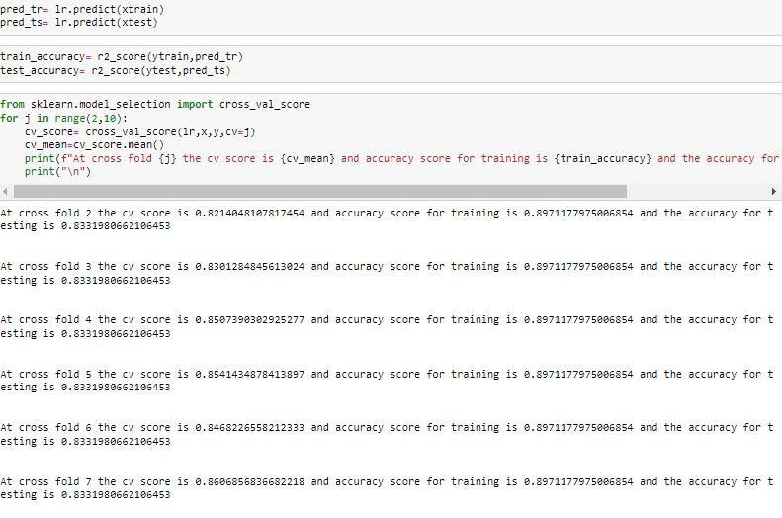

Slide 24
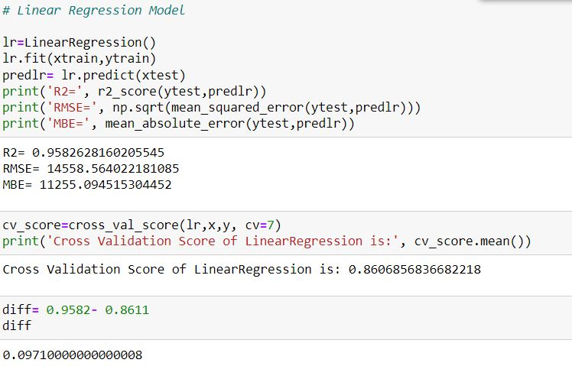
The best random state is found to be 32, cv=7. We shall run the other models with this random state and cv.
Linear Regression

Slide 25
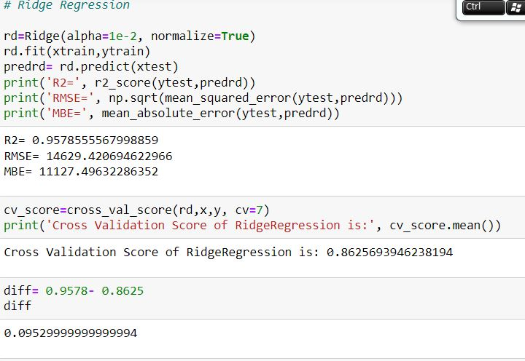
Ridge Regression

Slide 26
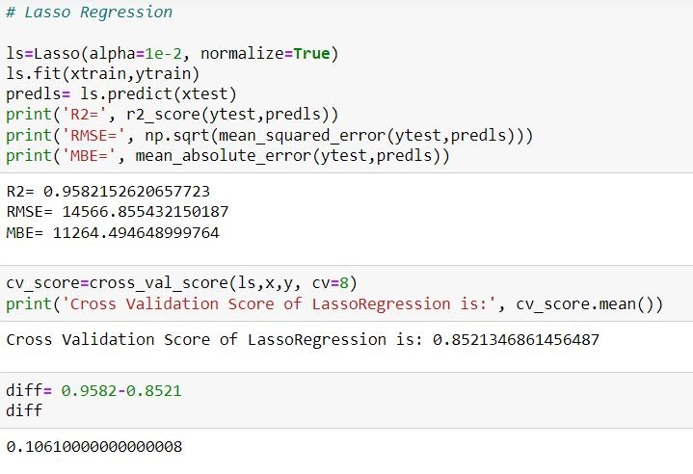
Lasso Regression

Slide 27
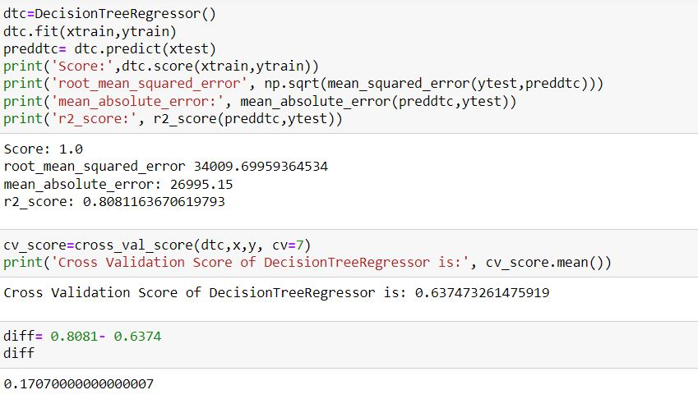
Decision Tree Regression

Slide 28
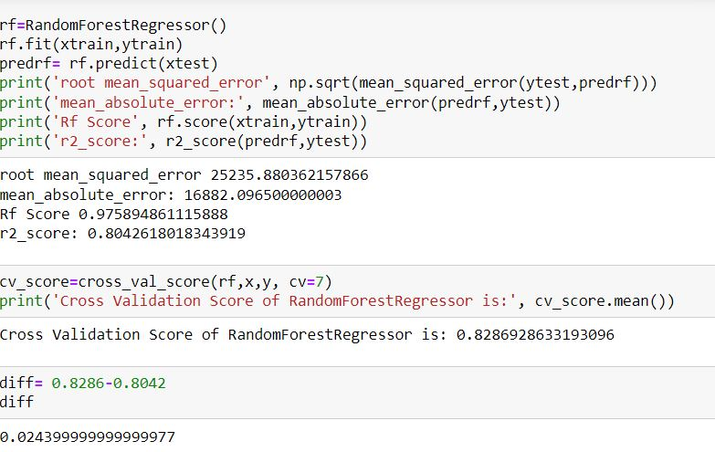
Random Forest Regression

Slide 29
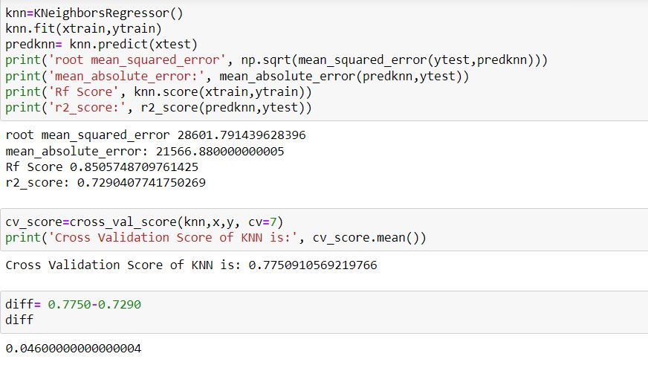
KNN

Slide 30
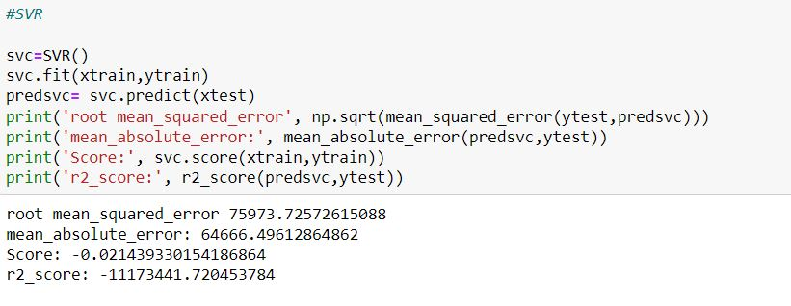
SVR

Slide 31
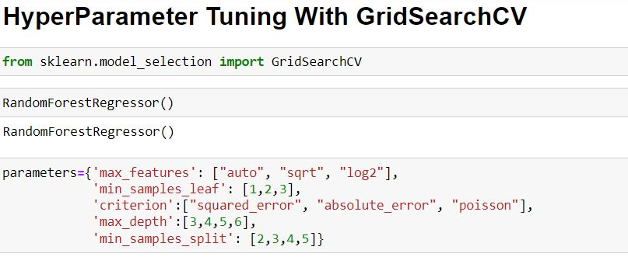
KEY METRICS FOR SUCCESS IN SOLVING PROBLEM UNDER CONSIDERATION
The key metrics used here were r2_score, cross_val_score, sd, MAE, MSE and RMSE. We tried to find out the best parameters and also to increase our scores by using Hyperparameter Tuning and we will be using GridSearchCV method.

Slide 32
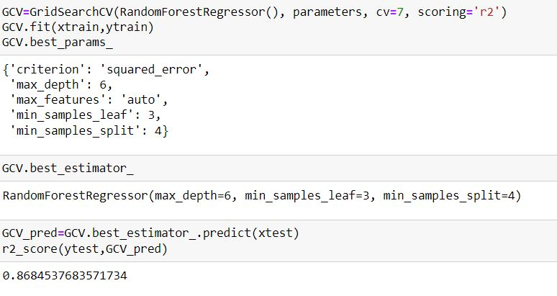

Slide 33
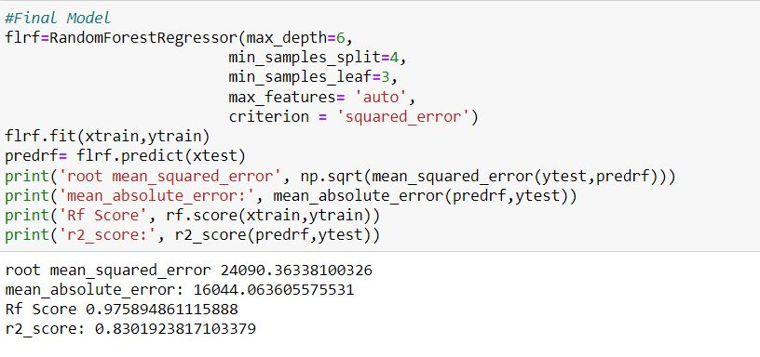
After tuning the Hyper parameters, we shall test it with our final model to get improved score of accuracy.

Slide 34

After tuning the Parameters and the final model is saved for future reference.
Using the test dataset and doing pre-processing
The test dataset is loaded and pre processing is done to make it ready for predicting the saleprice.

Slide 35
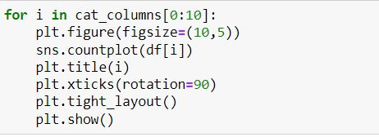
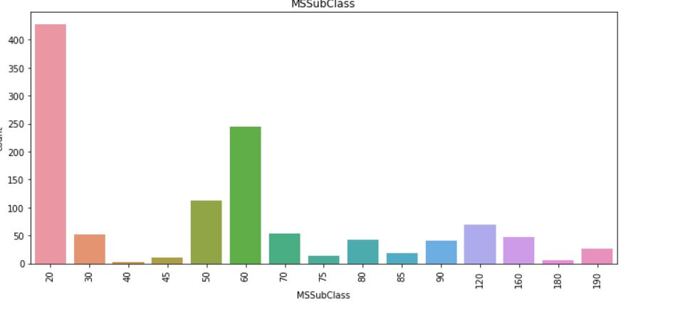
DATA VISUALIZATION
Now, we will see the different plots done with this dataset in order to know the insight of the data present.
UNIVARIATE ANALYSIS

Slide 36
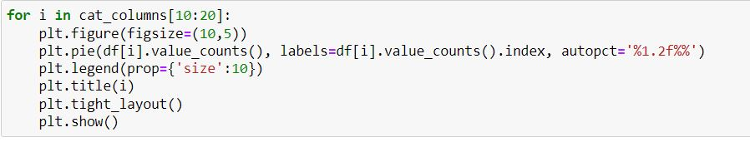
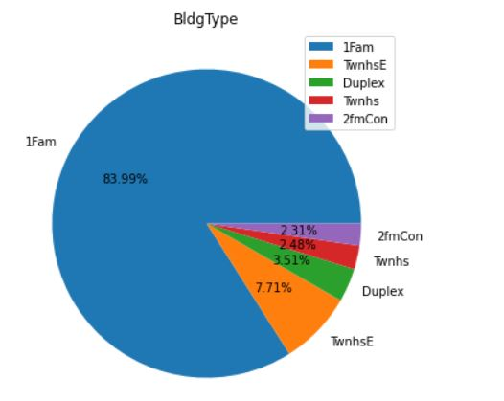

Slide 37
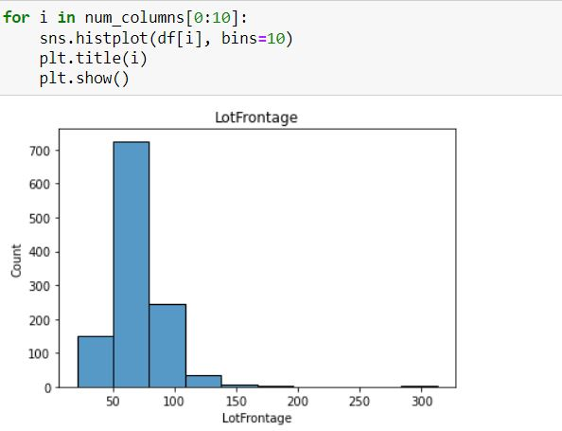

Slide 38
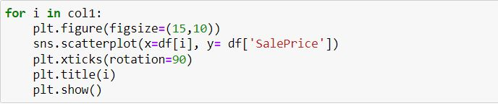
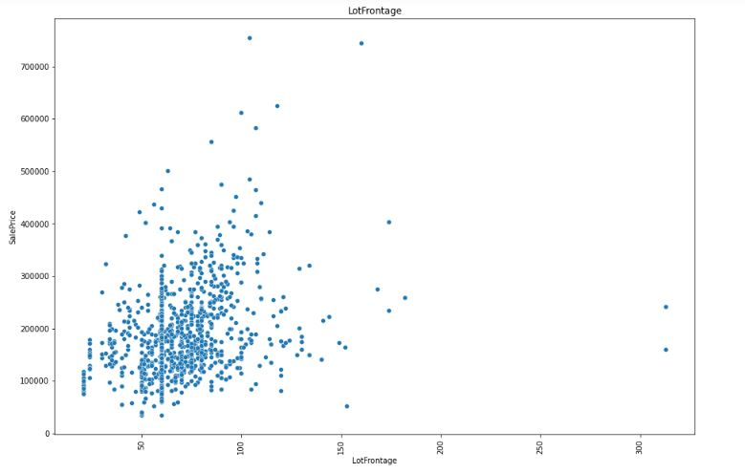
BIVARIATE ANALYSIS

Slide 39
CONCLUSION
After getting an insight of this dataset, we were able to understand that the Housing prices are done on basis of different features.
First, we loaded the train dataset and did the EDA process and other pre-processing techniques like skewness check and removal, handling the outliers present, filling the missing data, visualizing the distribution of data, etc.
Then we did the model training, building the model and finding out the best model on the basis of different metrices scores we got like Mean Absolute Error, Mean squared Error, Root Mean Squared Error, etc.
We got Random Forest Regressor as the best algorithm among all as it gave more r2_score and cross_val_score. Then for finding out the best parameter and improving the scores, we performed Hyperparameter Tuning.
We saved the model in a pickle with a filename in order to use whenever we require.
Then we used the test dataset and performed all the pre-processing pipeline methods to it.

Slide 40
LEARNING OUTCOMES OF THE STUDY IN RESPECT OF DATA SCIENCE
Price Prediction modeling – This allows predicting the prices of houses with respect to different factors affecting the prices in the real time scenarios.
Prediction of Sale Price – This helps to predict the future revenues based on inputs from the past and different types of factors related to real estate & property related cases. This is best done using predictive data analytics to calculate the future values of houses. This helps in segregating houses, identifying the ones with high future value, and investing more resources on them.

Slide 41
Limitations of this work and Scope for Future Work
Many features have NaN values more than 50%, and imputation of them can decrease the effectiveness. And dropping them had the loss of data.
The biggest limitation we observed was that not all categories of a particular feature were available in the training data. So, if there were new category in the test data the model would not be able to identify that.
The high skewness of data reduces the effectivity.
we can increase the efficiency of a model by selecting a better method to remove outliers and skewness also how to make the search of perfect model in a way that if we want to change some parameters in model then we don't have to run all the model again.

Slide 42
Thank You

